Slide 1

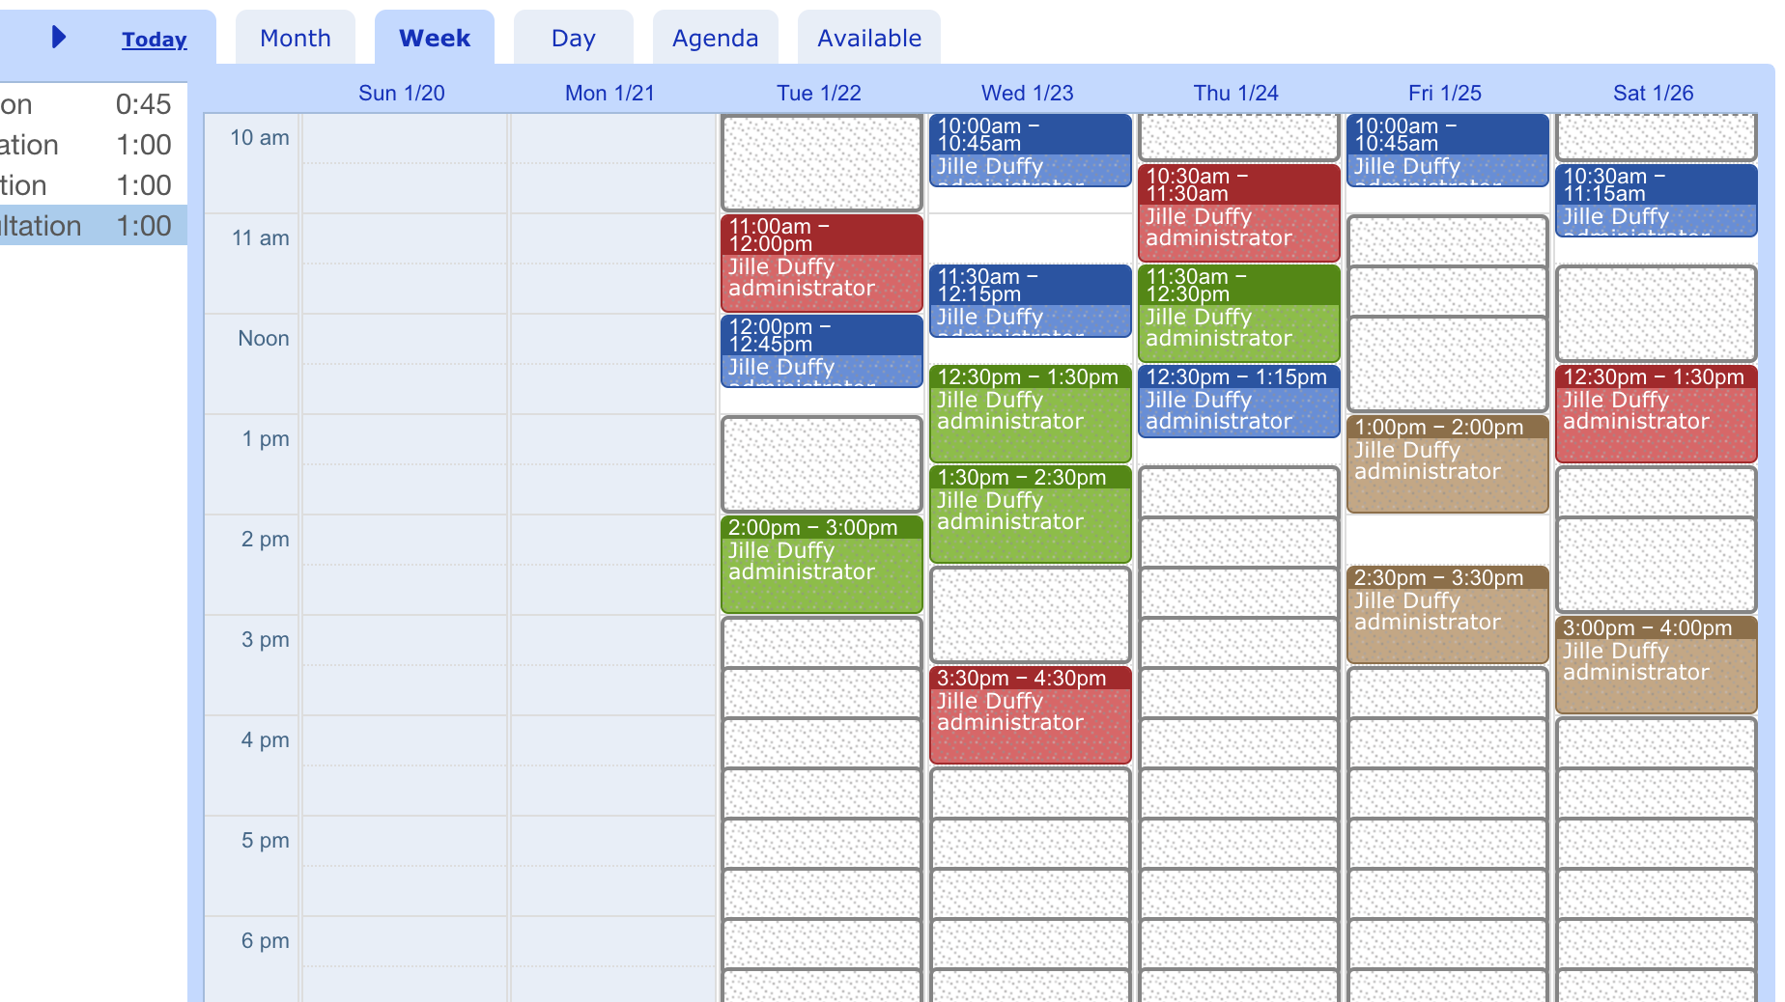
Appointment scheduler
Jamal Franklin
An appointment tracker for dentists to use with their clients

Slide 2
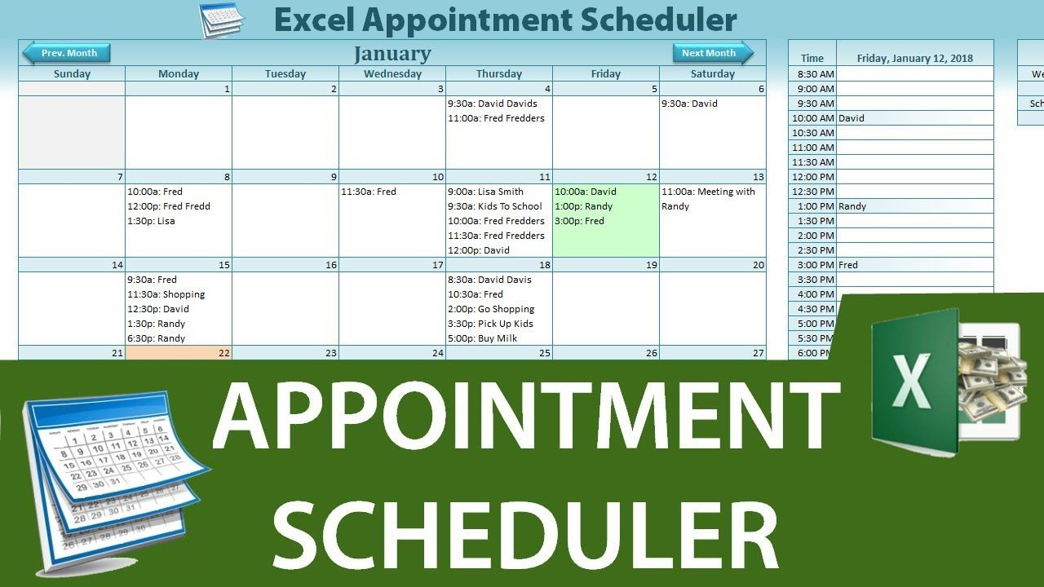
Summary of appointment tracker
The main point of having this sort of code is to allow clients to easily schedule their appointments with their dentists
Appointment tracker will allow clients to input the information such as their dentist, their concern and other items so they can probably pick the right dentist and pick a time for that dentist.
https://github.com/ksu-is/Appointment-Tracker-Dental-1

